Slide 1
GovTech M365 Copilot
Agent-a-thon
Reuel Ngo

Slide 2

Facilitators
[Facilitator 1]
[Facilitator 2]
[Facilitator 3]
[Facilitator 4]
[Facilitator 5]
[Job Title]
[Job Title]
[Job Title]
[Job Title]
[Job Title]
[Facilitator 6]
[Facilitator 7]
[Facilitator 8]
[Facilitator 9]
[Facilitator 10]
[Job Title]
[Job Title]
[Job Title]
[Job Title]
[Job Title]

Slide 3
Welcome to the Agent-a-thon
Team,
Welcome to the Agent-a-thon. Today you’ll design end-to-end processes using multiple agents to streamline business operations and deliver meaningful business outcomes.
Time is short, so make it count. Your experts are here to help!
Here are the timings for the day.
Top Tips
Watch the time. It’s easy to get caught up producing slides and not have a well-defined presentation.
You are designing an end-to-end process using multiple agents – describe the input and output of each agent, explain how the outputs feed into the next step. Focus on the approach rather than the exact prompts
Every use case must involve at least 1 agent, you can use Copilot Chat and/or Copilot in the O365 apps, e.g. Copilot in Outlook.
Keep your workflows and agents within the tool capabilities. This is the art of the possible NOT the impossible.
Judges want the most impactful Workflows & Agents — a workflow saving 10 minutes used 20 times a week beats one saving 2 hours once.
Send your slides across on time!
09:00 – 09:20 | Welcome + Kickoff
09:20 – 10:00 | Agents in M365 Copilot + Judging Criteria
10:00 - 11:30 | Hack Session
11:30 | ‼️ Ensure presentations are submitted in the Teams channel for your area.
11:30 - 12:45 | Pitching, Judging and awards

Slide 4
Why Agents?

Slide 5

What are agents?
AI designed to perform a task
Tasks can vary in level of complexity and capabilities depending on your need
Simple
Advanced
Generation
Generate summaries, images, audio, and more with an AI model and inputs.
Retrieval
Retrieve information from grounding data, reason, summarize, and answer
user questions
Action
Take actions to automate workflows, and replace repetitive tasks for users

Slide 6
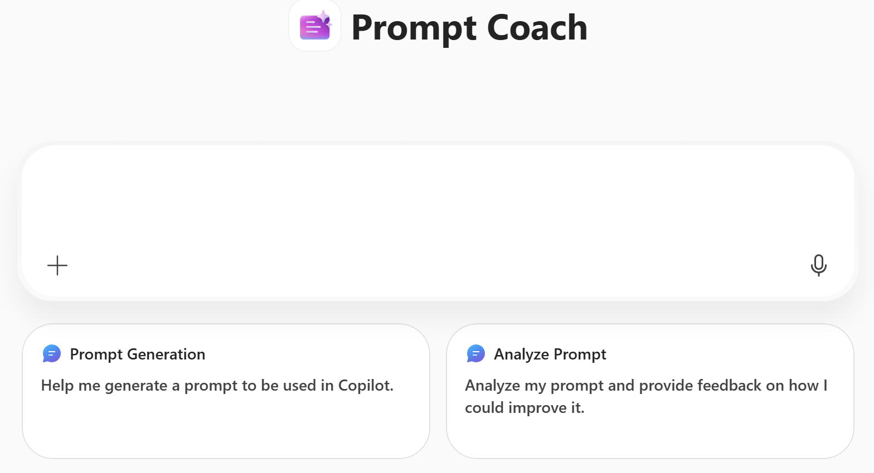
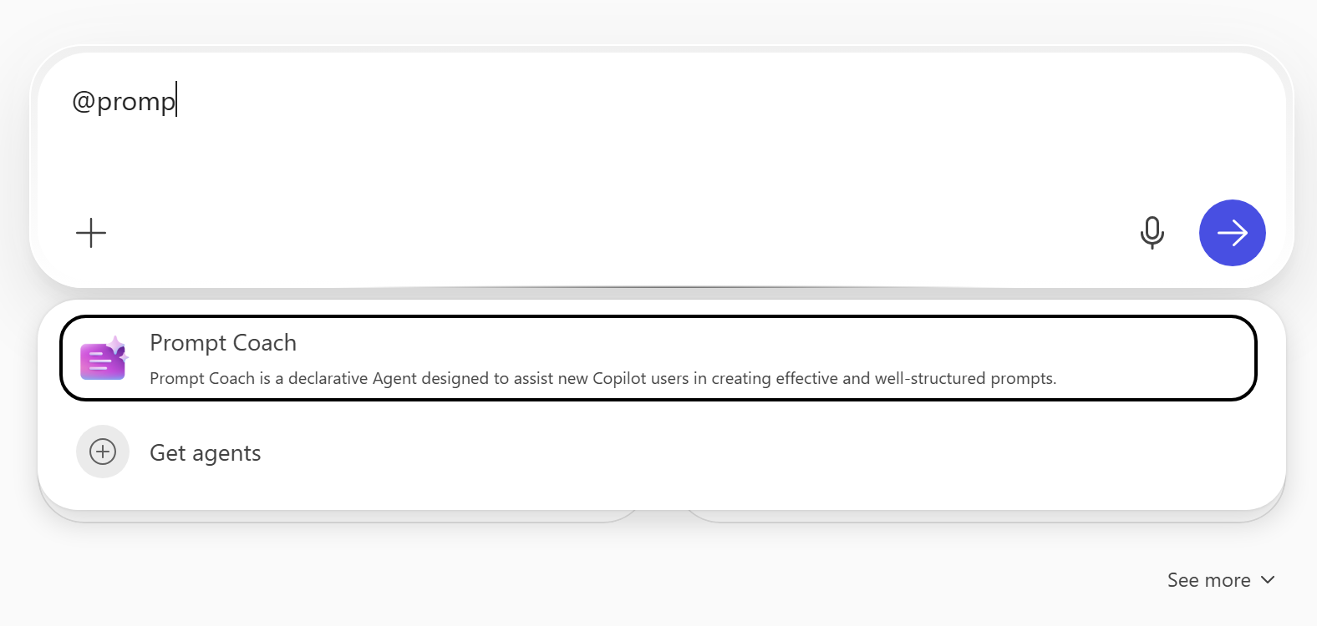
Agents User Experience
Immersive
In-context
Immersive Experience
The full experience of the Copilot app in Microsoft 365. Users chat directly with the agent embedded in Microsoft 365 Copilot or Copilot Chat.
In-context Experience
Users interact in the context of an app. Users can @-mention the agent and interact with it directly within the app experience.

Slide 7

















M365 Copilot Agents
À la carte your Agent-a-thon stack: pick the agents that fit your use case.
RESEARCH & ANALYSIS
RESEARCH & ANALYSIS
CREATE
CREATE
CREATE
Researcher
Analyst
Excel (Agent)
PowerPoint (Agent)
Word (Agent)
Deep research across your work data and the web, reasoned into a cited point of view.
Runs multi-step data analysis and code on your datasets to surface trends and insights.
Builds sheets, organises data and writes working formulas so insights are ready fast.
Creates complete decks from a topic or goal, drawing on your own work content.
Drafts, rewrites and summarises documents with clear structure and professional formatting.
COACHING
COACHING
COACHING
LEARNING
COACHING
Idea Coach
Writing Coach
Prompt Coach
Learning
Meeting Coach
Makes brainstorming engaging, turning raw ideas into agendas and action plans.
Sharpens the clarity, structure and tone of your writing for any audience.
Turns rough asks into effective Copilot prompts so you get better answers.
Helps you master subjects and build skills through personalised learning paths.
Sets objectives, agendas and roles, keeps meetings on track and captures actions.
KNOWLEDGE
COMMUNICATIONS
CUSTOM
PRODUCTIVITY
LEARNING
SME Finder
Request for Proposal
Custom Agent
Plan my Day
Quiz Tutor
Finds credible experts within your organization for any topic, with cited evidence and outreach drafts.
Helps teams craft tailored, high-quality RFP responses and proposals faster.
Build your own agent on org knowledge, instructions and capabilities.
Compiles a morning briefing from Microsoft 365, balancing priorities and wellbeing.
Creates interactive quizzes from your training docs and coaches you on every answer.
COMMUNICATIONS
KNOWLEDGE
COMMUNICATIONS
PRODUCTIVITY
PRODUCTIVITY
Executive Briefings
Personal News
Corporate Comms
Status Update
Interview Questions
Builds brand-aligned briefing packs and post-meeting summaries from M365 content.
30-second org news briefing, tagged by priority and personalized to you.
Crafts brand-aligned internal and external comms in the company's tone and style.
Turns your M365 activity into clear daily, weekly or quarterly status updates.
Generates fair, role-specific interview questions that stay relevant and inclusive.

Slide 8

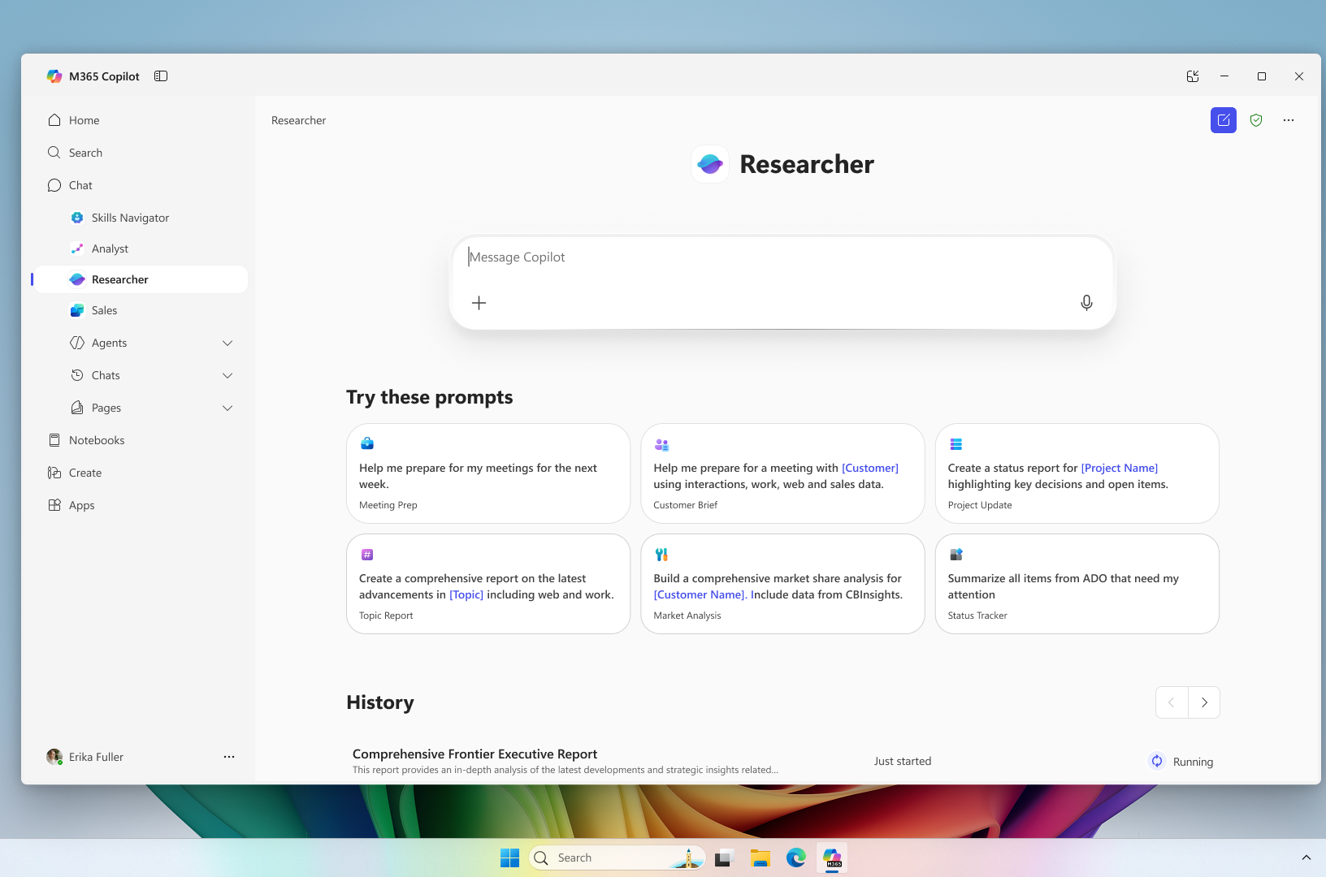
Researcher
The Researcher agent gives organizations the capability they’d expect from a highly paid strategist or researcher
Combines the most advanced deep reasoning models with Copilot Chat’s web- and work-grounding, as well as its agent ecosystem,
Provides well-reasoned responses to complex prompts with the data that matters most.​
Gives users a thought partner that can perform advanced reasoning grounded in their unique context
Gives organizations on-demand access to the types of work they typically expect from highly paid employees

Slide 9


Researcher Modes
Auto Let researcher decide | Model Council vs Multiple researchers, multiple reviews | Critique GPT Claude researches reviews | GPT GPT only | Claude Claude only
Automatically selects the best approach based on the question | Both GPT and Claude independently research. Researcher shows both reports and a summary of where they agree, disagree and contribute different insights | GPT writes a report. Claude reviews the report to improve the structure, completeness, source quality | GPT researches and produces the report | Claude Researches and produces the report
Best for Most research questions | Best for Exploring different perspectives and comparing them | Best for reports where you want AI to review | When you want GPT research output | When you want Claude research output

Slide 10
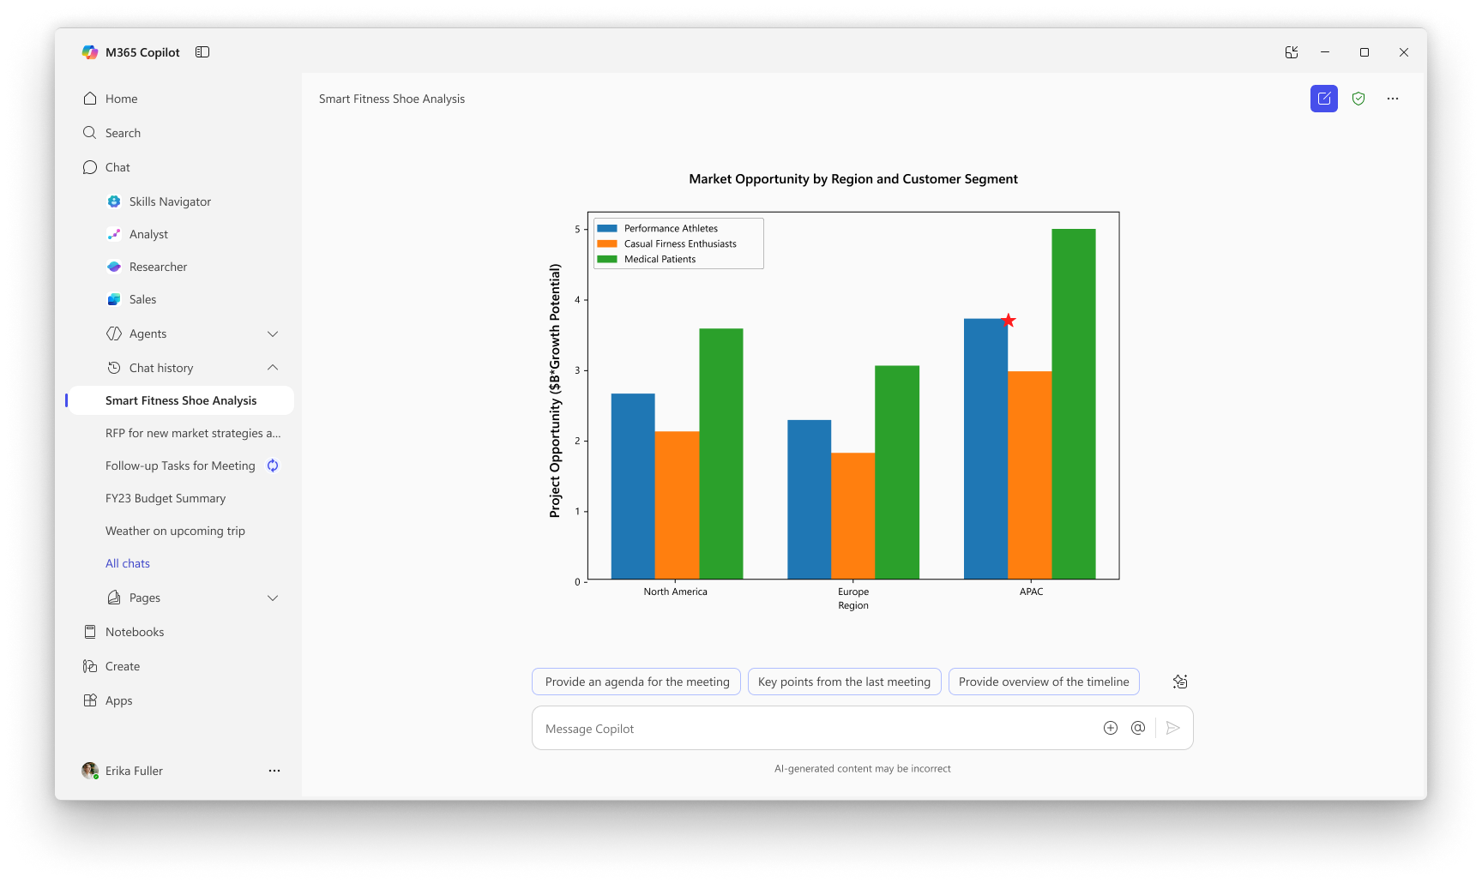
Analyst
Analyst thinks like a skilled data scientist, so you can go from raw data to insights in minutes. ​
Built reasoning models and optimized to do advanced data analysis at work
Analyst uses chain-of-thought reasoning to progress through problems iteratively, to refine its reasoning and provide a high-quality answer
Runs Python to tackle your most complex data queries— you can view the code it’s running in real time to check its work

Slide 11
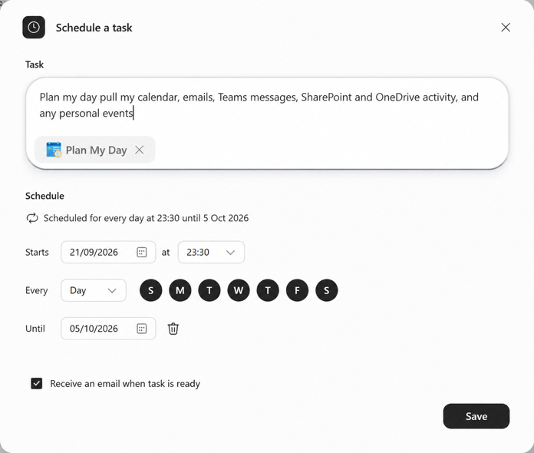


Working with Agents

Slide 12
End

